Slide 1
Version Control with Git and GitHub
CDIPS Pre-Workshop Week
Monday, July 6, 2015
Michael Cole

Slide 2

Today’s Outline
Introduction to Git
Getting Started (Installation / etc.)
Basic Git Commands
Repository Basics
Making Changes
Not covered: Rebasing
Branching and Merging
Remote Repos
Introduction to GitHub
Cloning a GitHub Repo

Slide 3
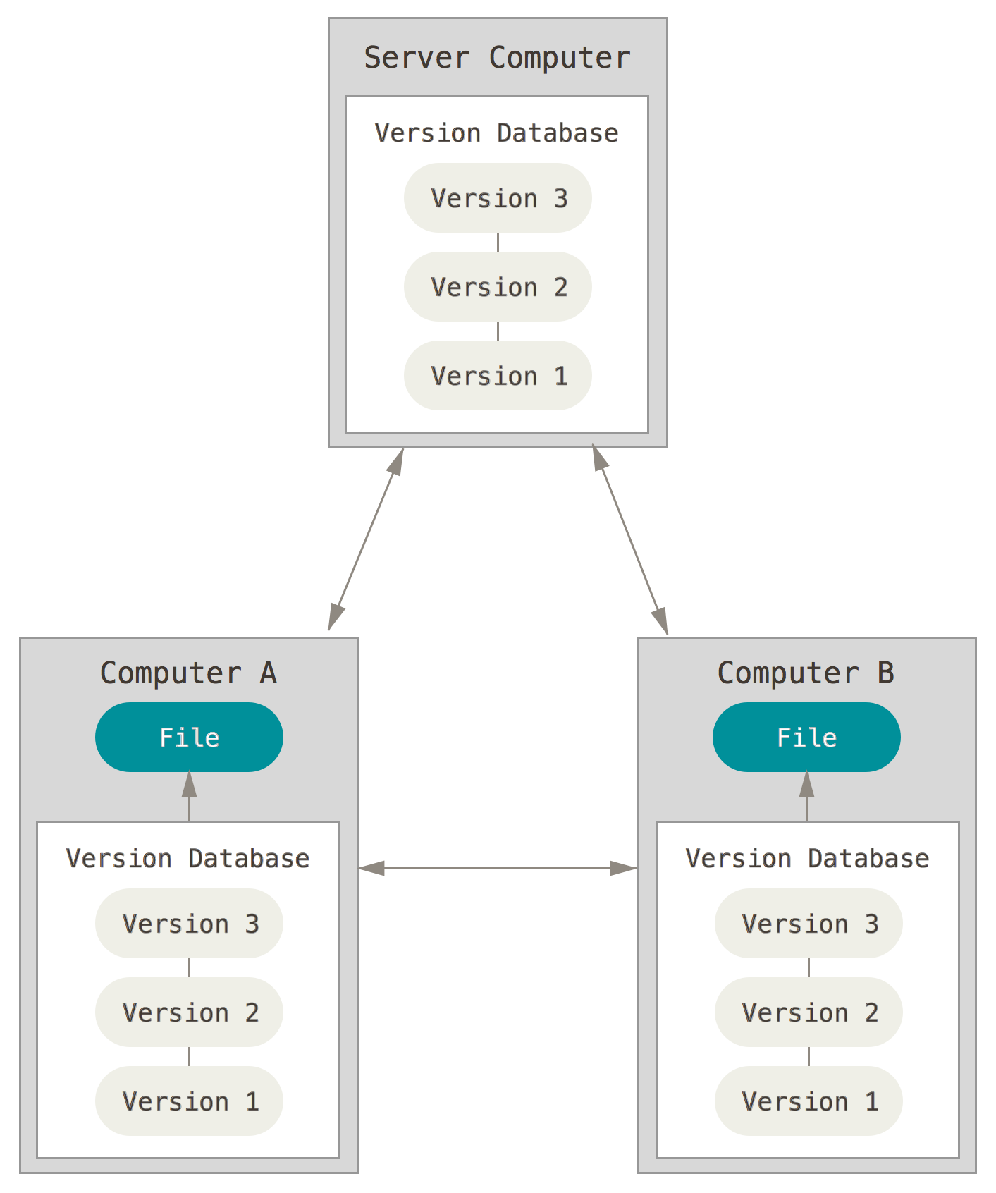
Introduction to Git
What is version control?
“Version control is a system that records changes to a file or set of files over time so that you can recall specific versions later.“
“A VCS [Version Control System] allows you to: revert files back to a previous state, revert the entire project back to a previous state, review changes made over time, see who last modified something that might be causing a problem, who introduced an issue and when, and more.”
http://git-scm.com/book/en/v2/Getting-Started-About-Version-Control
Distributed Version Control System

Slide 4
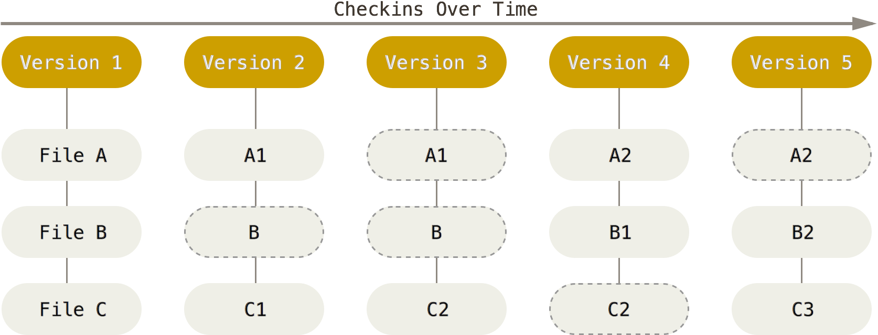
Introduction to Git
What is git, in a nutshell?
Version control
Fast
Simple
Strongly supports non-linear development (thousands of branches)
Fully distributed
Able to handle large projects efficiently
http://git-scm.com/book/en/v2/Getting-Started-A-Short-History-of-Git
Git’s approach is to take snapshots of the working directory at every commit

Slide 5
Set up Git + Github
Set up git on your personal computer:
https://git-scm.com/book/en/v2/Getting-Started-Installing-Git
Windows users may want to install the GitHub application:
https://windows.github.com/
Configure git:
https://git-scm.com/book/en/v2/Getting-Started-First-Time-Git-Setup
Set up GitHub account:
https://github.com/join

Slide 6
Command Line Git
Navigate inside the git working directory
Contains .git directory
Use git commands:
git <verb>
Or use the –C flag to run git commands outside of the working directory:
git –C <path> <verb>

Slide 7
Repository Basics
git init:
Initialize git repository in current (or named) directory
git config -l:
List configured git/repo parameters
git status:
Check status of the repository
git log:
See trace of commits
--graph
Visualize commit tree

Slide 8
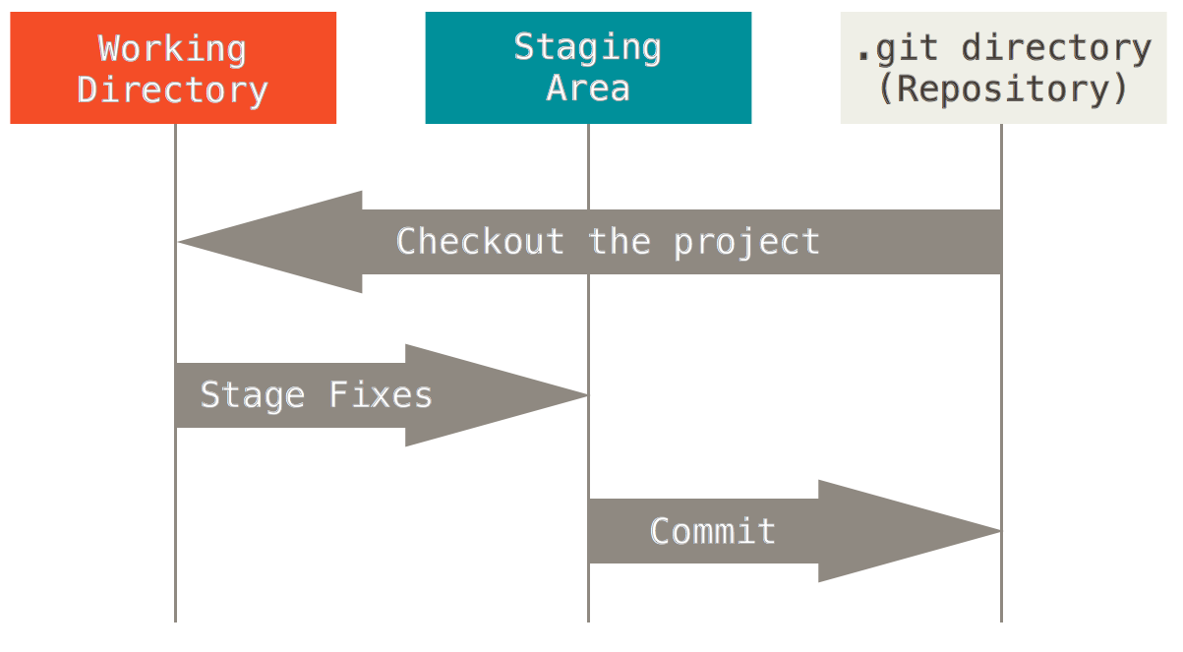
Git Commit Structure
We use git in three stages:
Working Directory
Modified Data
Staging Area (Index)
Staged Data
Git Directory
Committed Data
https://git-scm.com/book/en/v2/Getting-Started-Git-Basics

Slide 9
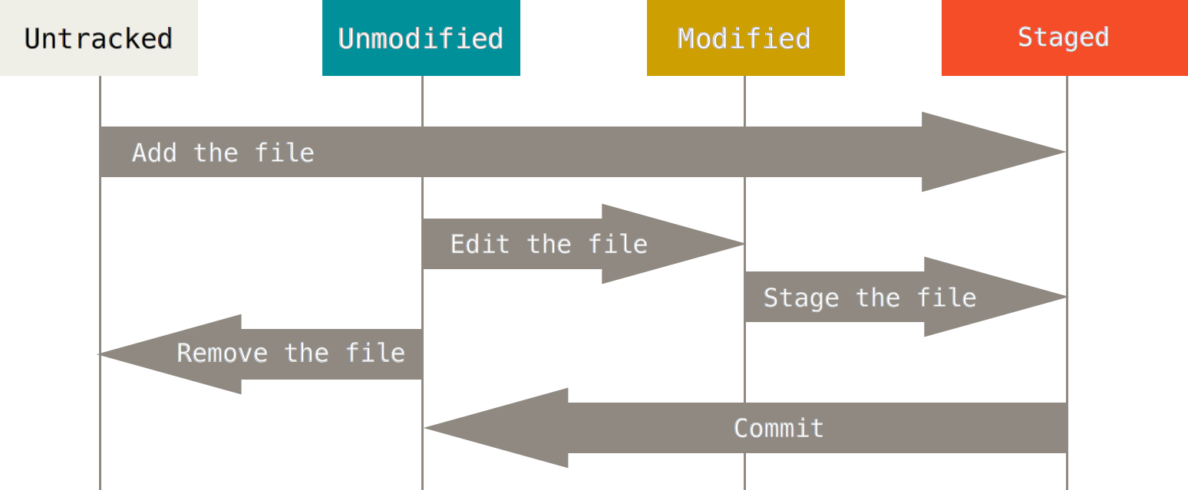
Making Changes
git add <file>:
Stage modified (or new) files for commit
git rm <file>:
Stage file removal for commit
git mv <file>:
Stage file for rename
git reset HEAD:
Unstage all changes
git commit:
Commit staged changes
-m for quick comment
-a to skip staging!
git reset HEAD~1
Undo last commit (consider --soft or --hard)

Slide 10
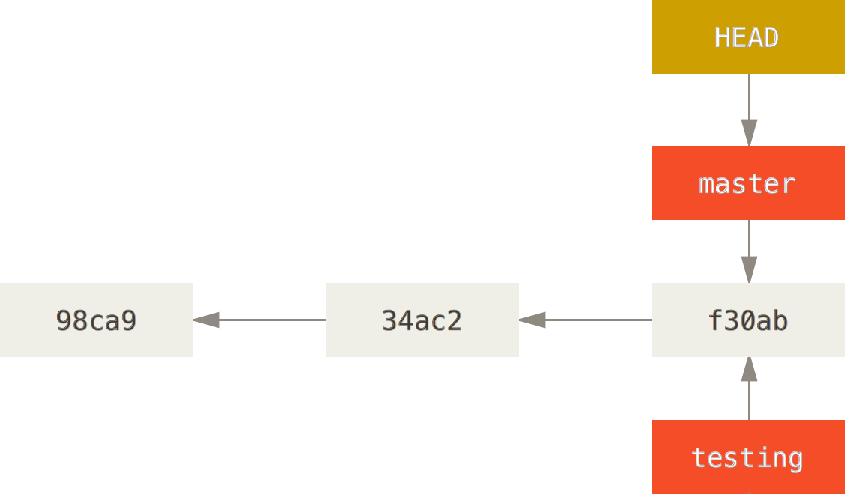
Basic Branching
What is a branch in git?
A branch is a pointer to a particular commit (snapshot of the repository)
The master branch is the canonical distribution branch (shared and up-to-date)
https://git-scm.com/book/en/v2/Git-Branching-Branches-in-a-Nutshell

Slide 11
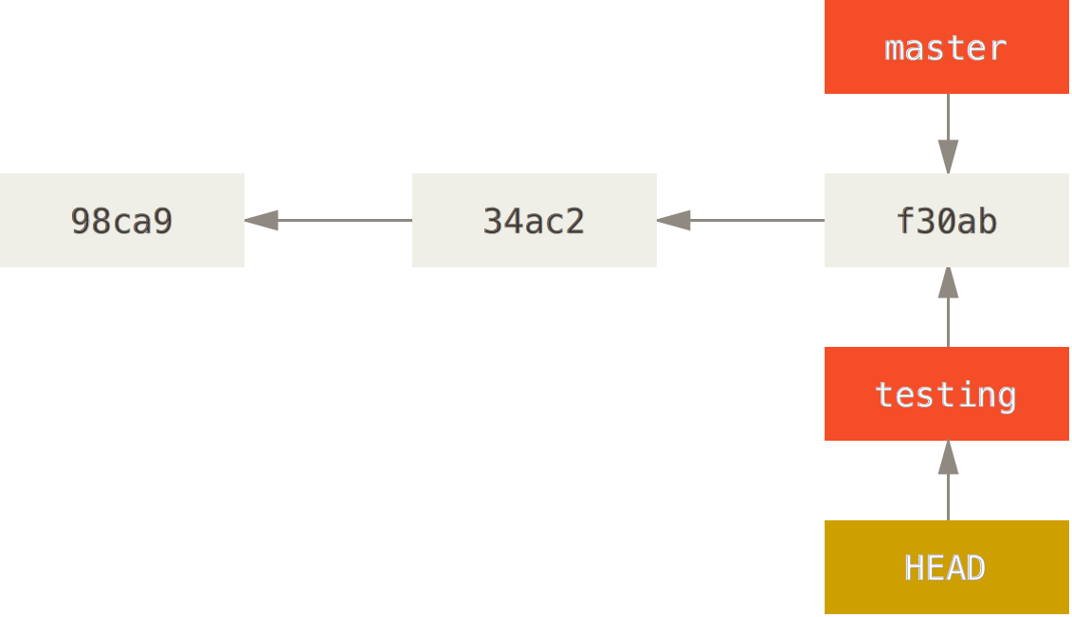
Basic Branching
What is a branch in git?
A branch is a pointer to a particular commit (snapshot of the repository)
The master branch is the canonical distribution branch (shared and up-to-date)
https://git-scm.com/book/en/v2/Git-Branching-Branches-in-a-Nutshell

Slide 12
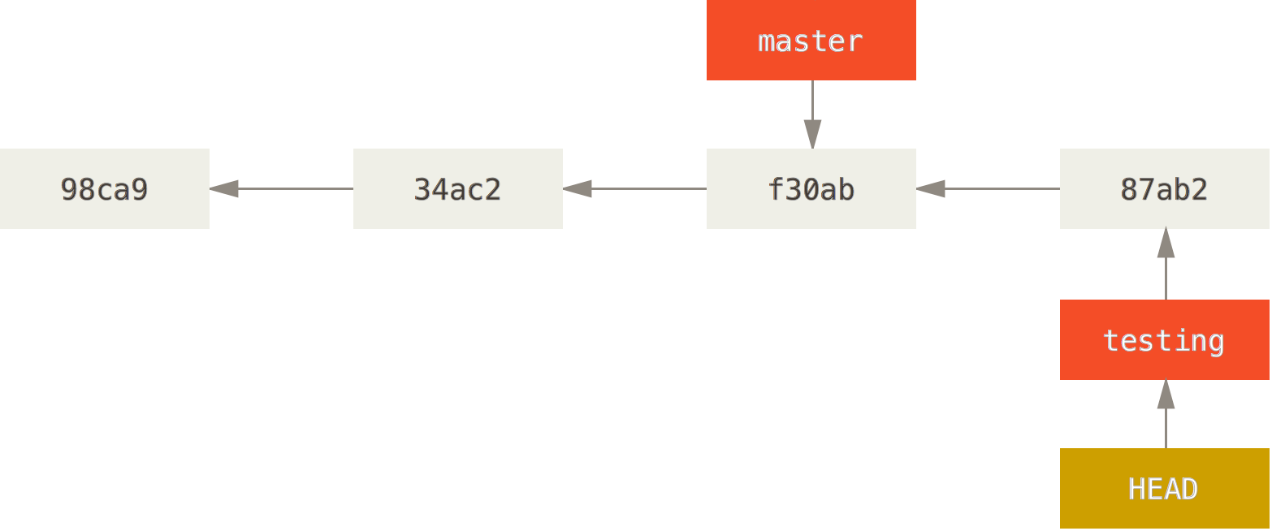
Basic Branching
What is a branch in git?
A branch is a pointer to a particular commit (snapshot of the repository)
The master branch is the canonical distribution branch (shared and up-to-date)
https://git-scm.com/book/en/v2/Git-Branching-Branches-in-a-Nutshell

Slide 13
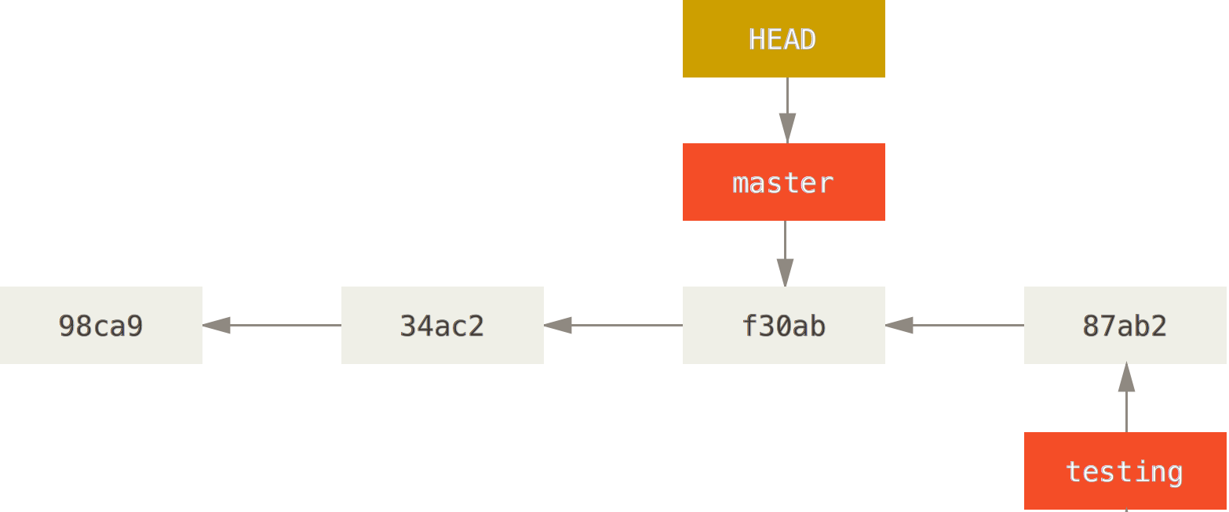
Basic Branching
What is a branch in git?
A branch is a pointer to a particular commit (snapshot of the repository)
The master branch is the canonical distribution branch (shared and up-to-date)
https://git-scm.com/book/en/v2/Git-Branching-Branches-in-a-Nutshell

Slide 14
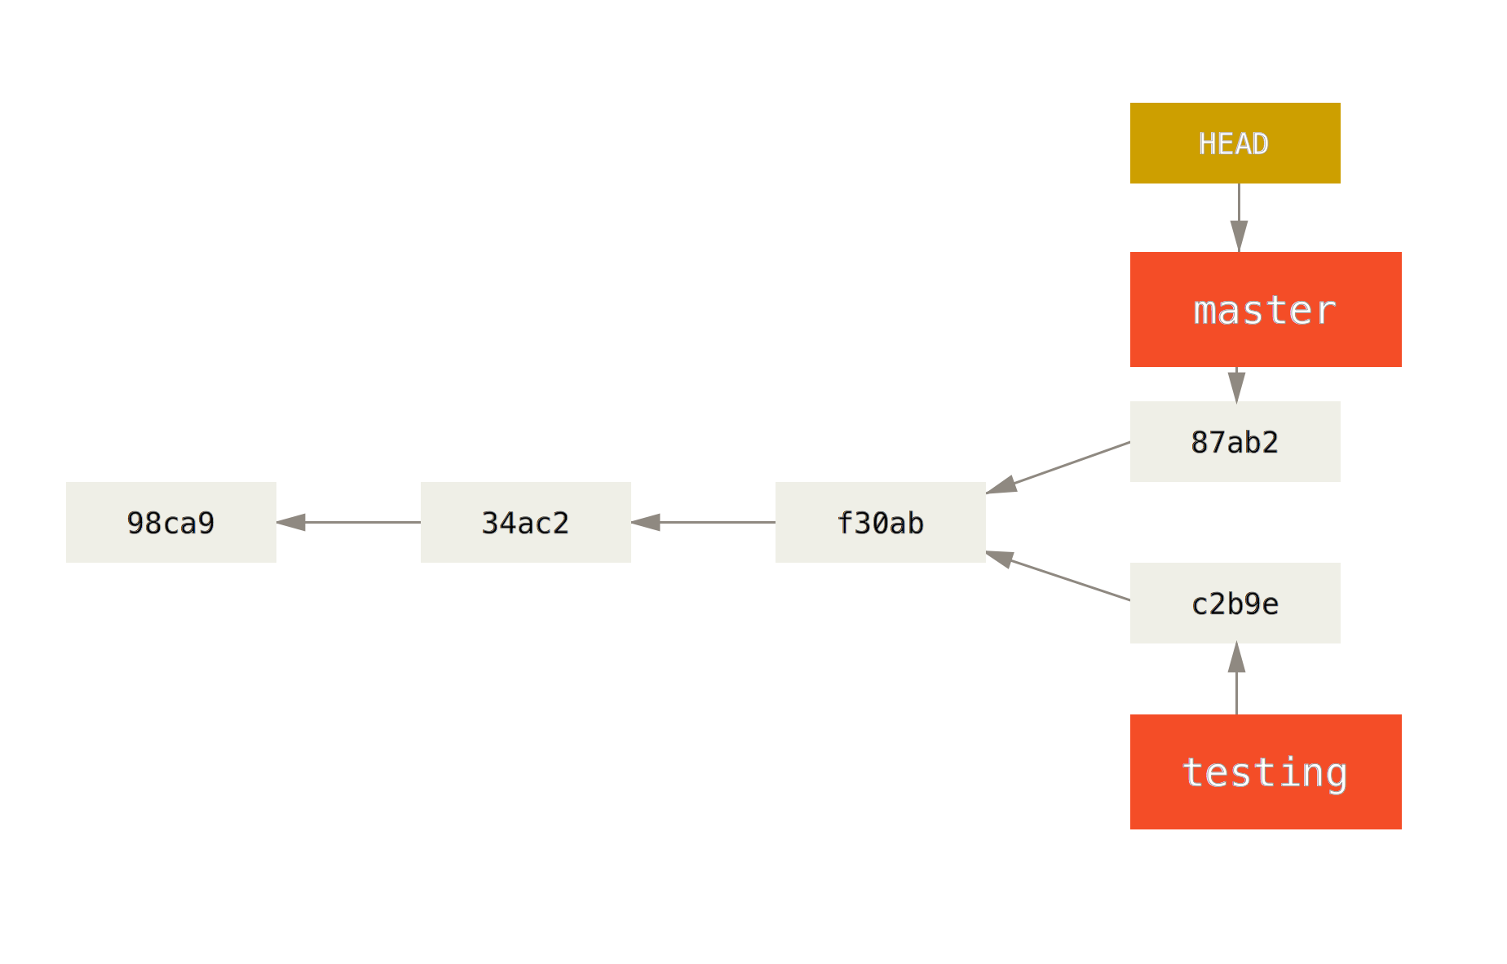
Basic Branching
What is a branch in git?
A branch is a pointer to a particular commit (snapshot of the repository)
The master branch is the canonical distribution branch (shared and up-to-date)
https://git-scm.com/book/en/v2/Git-Branching-Branches-in-a-Nutshell

Slide 15
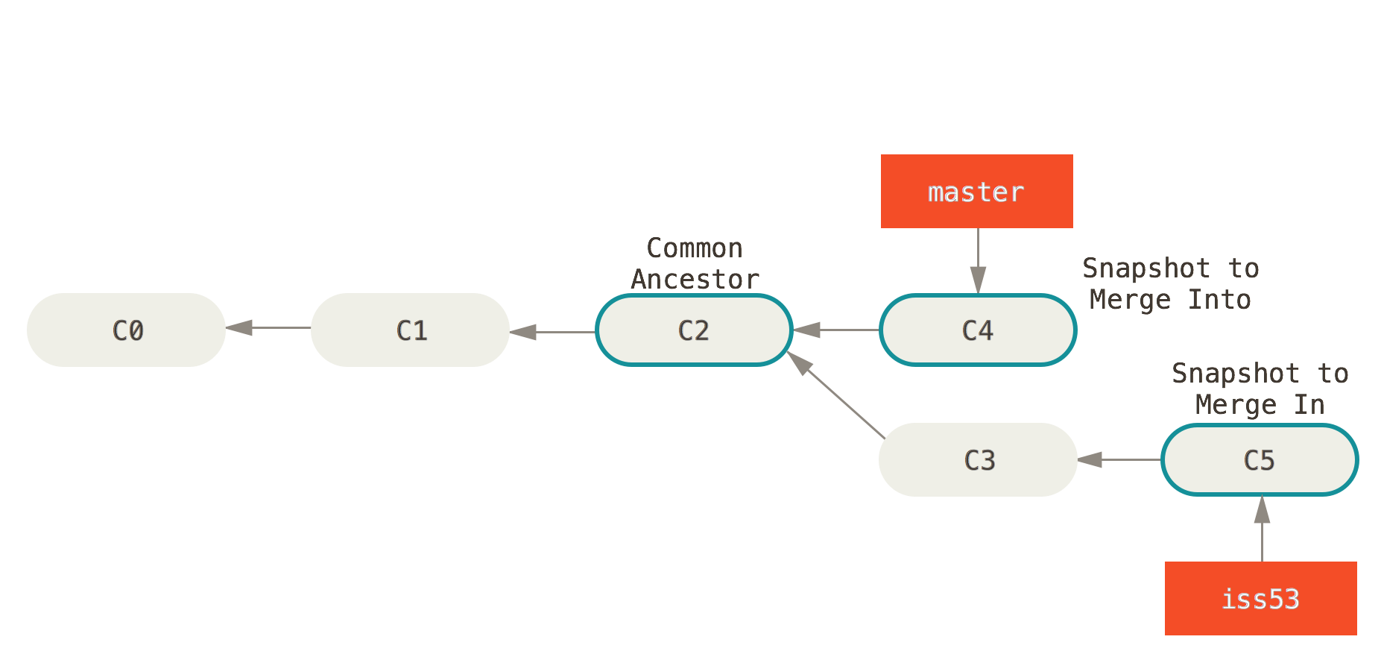
Basic Merging
What is a merge in git?
A merge is a commit that includes changes made in two branches.
If the same data was edited in both branches, the merge must be resolved by a user.
https://git-scm.com/book/en/v2/Git-Branching-Basic-Branching-and-Merging

Slide 16
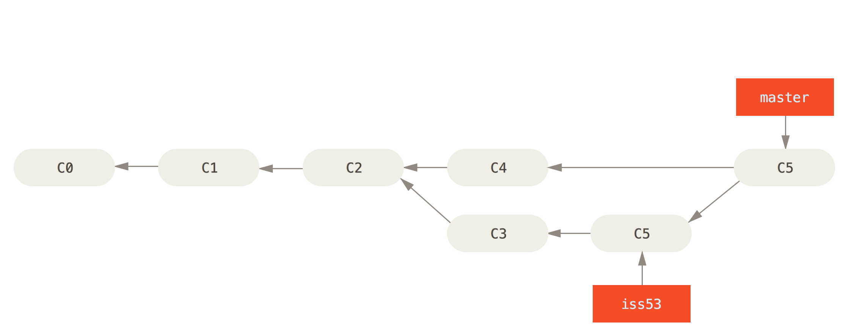
Basic Merging
What is a merge in git?
A merge is a commit that includes changes made in two branches.
If the same data was edited in both branches, the merge must be resolved by a user.
https://git-scm.com/book/en/v2/Git-Branching-Basic-Branching-and-Merging

Slide 17
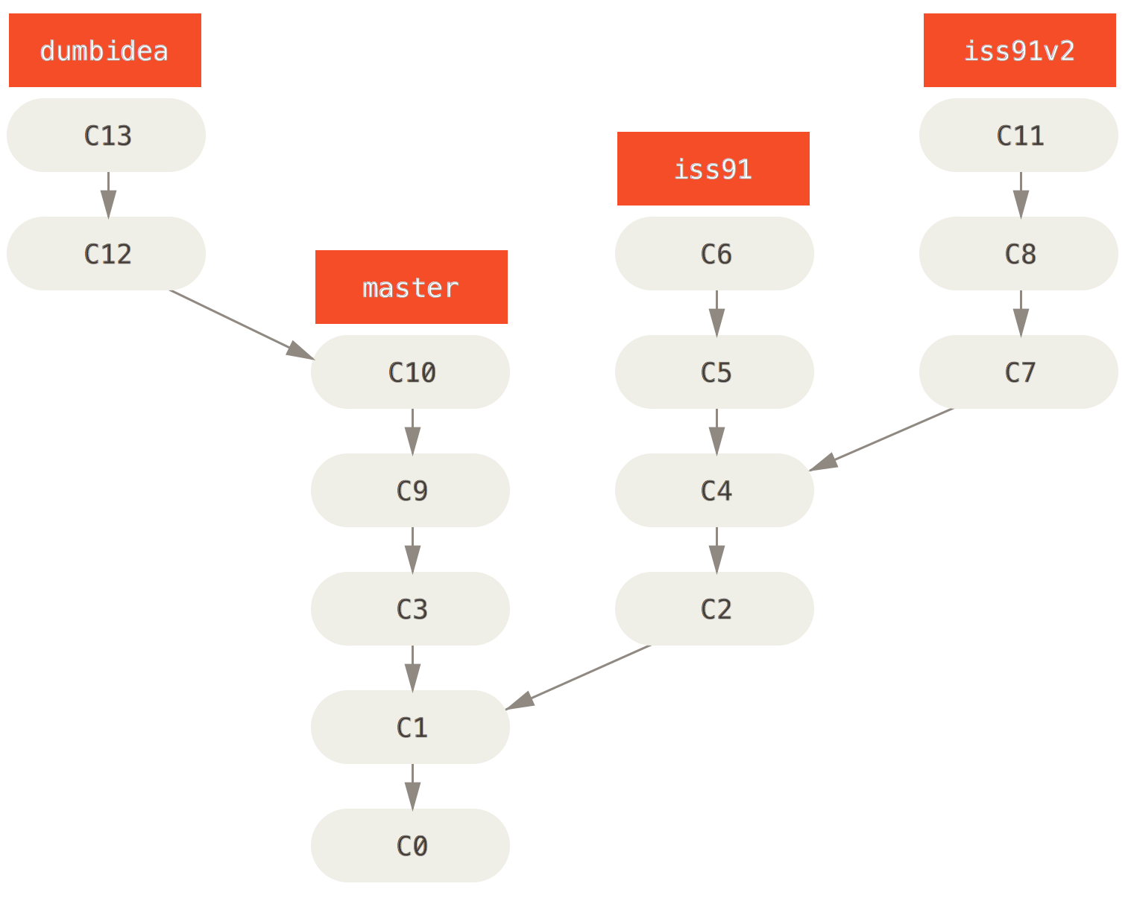
Branching and Merging
git branch <branch>:
Create new branch at current (or earlier) commit
git checkout <branch>:
Decompress branch to working directory – move to it
Can be used to decompress select files from other branches
git branch -d <branch>:
Delete branch
git merge <branch>:
Merge with other branch

Slide 18
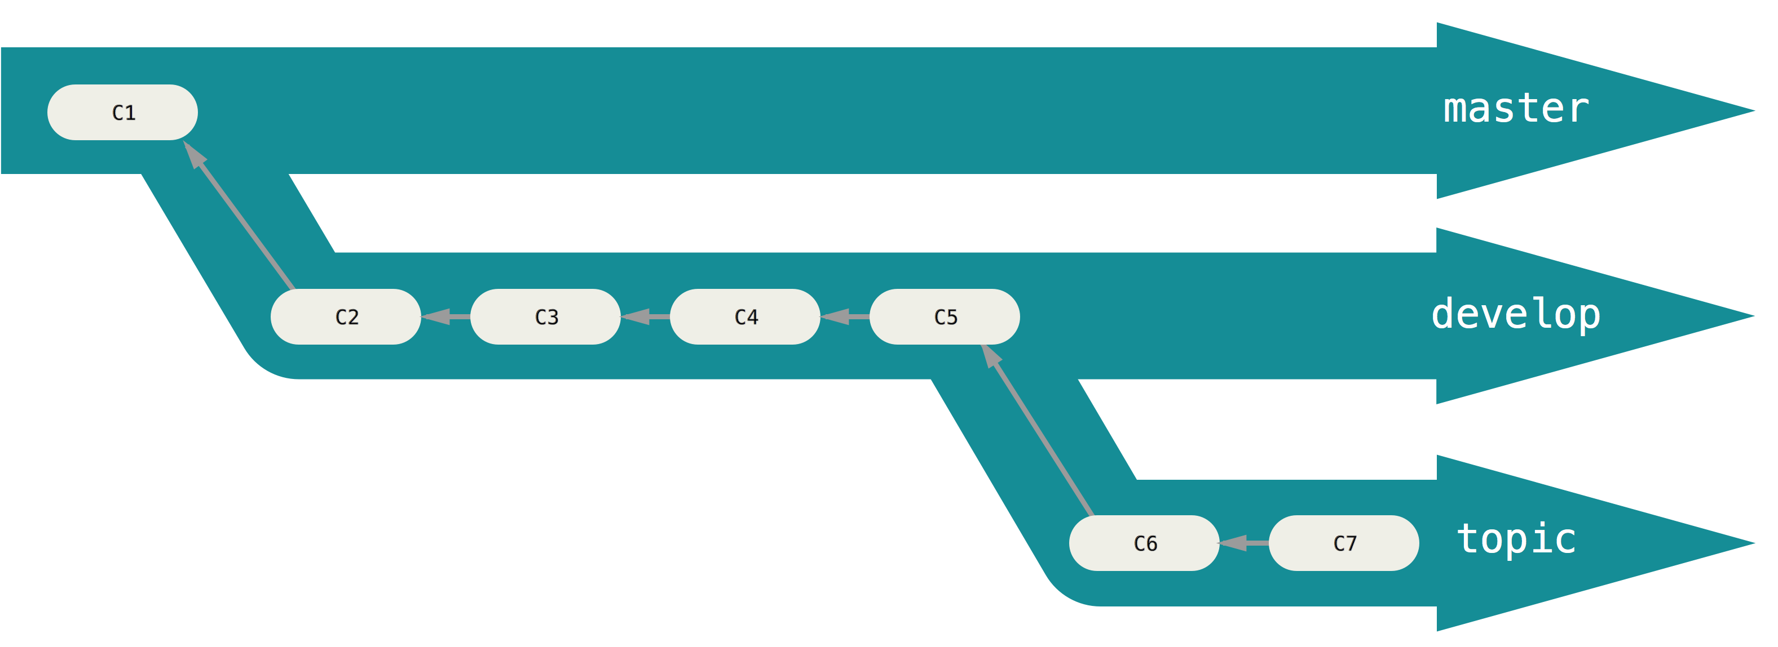
Merging: When and How?
Consider a master branch and a dev branch
When:
The master branch has been updated with useful tools that you want to use for your own development
Fixes have been committed to core code in the master branch
You want to stay up-to-date…
Merge branch master into dev
git checkout dev
git merge master

Slide 19
Merging: When and How?
Now suppose:
You want to add code produced in the dev branch to the master branch
You’ve made edits you want to add to the master branch
Merge branch dev into master
git checkout master
git merge dev
Merge resolution effects everyone on master!

Slide 20
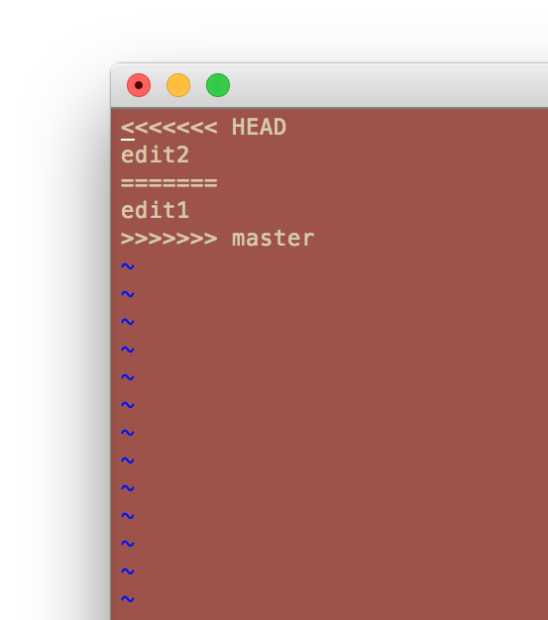
!!!CONFLICT!!!
Don’t panic!
Well.. not right away…
Look for conflict resolution markers
<<<<<<<, =======, >>>>>>>
Remove markers and resolve conflict manually
stage and commit – done!
git mergetool
Best way to avoid conflicts:
Work on different files, or different modules within the same file
Give up? Just abort!
git merge --abort

Slide 21
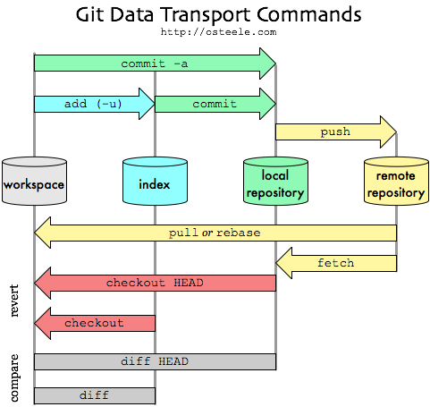
Remote Repos
git clone <url>:
Clone a remote repository
git fetch:
Fetch all changes from remote repo
Current branch must track a remote branch, often “origin master”
git pull:
Fetch and merge
git push:
Push commits to remote repo

Slide 22
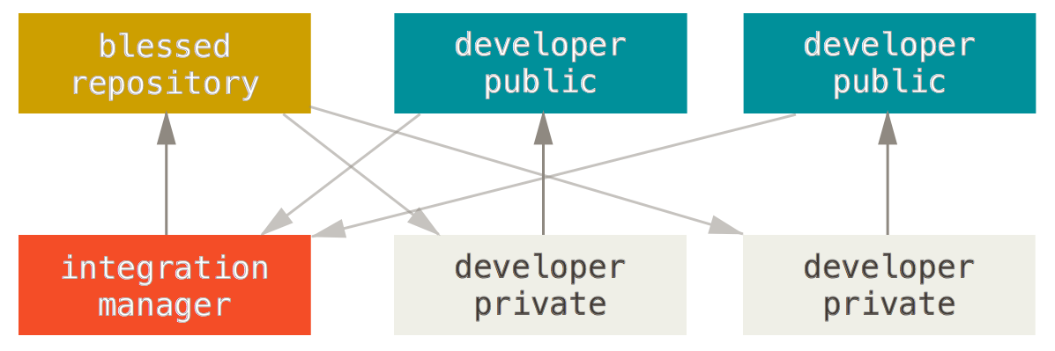
GitHub: An Integration-Manager Workflow
A fork is a personal copy of another user's repository that lives on your account.
Pull requests are proposed changes to a repository submitted by a user and accepted or rejected by a repository's collaborators.

Slide 23

Clone a GitHub Repo

